Slide 1
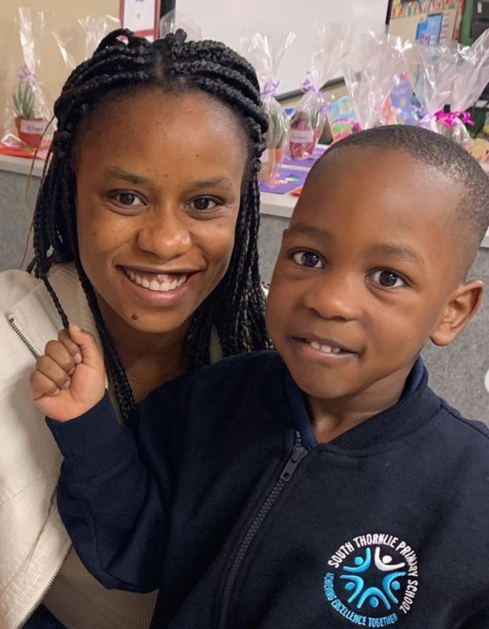
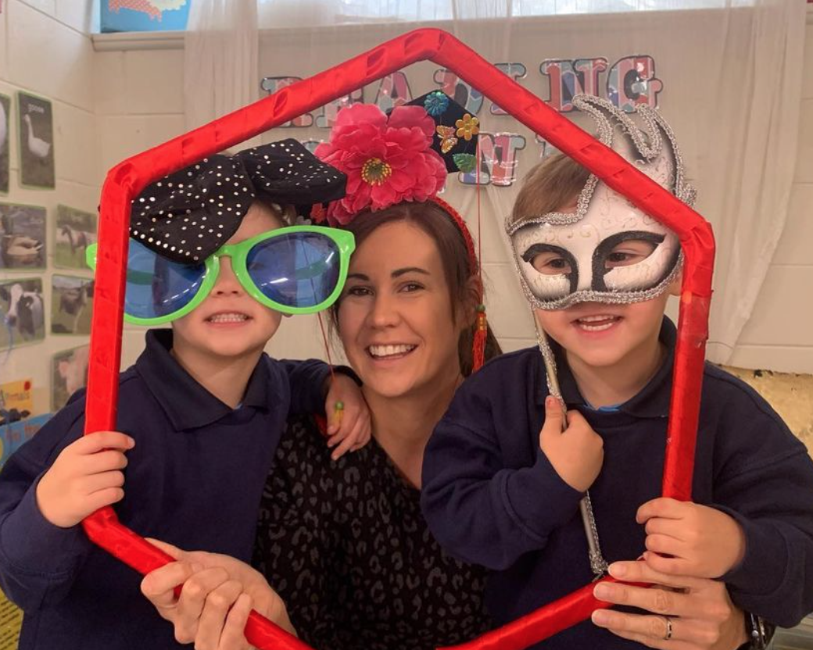
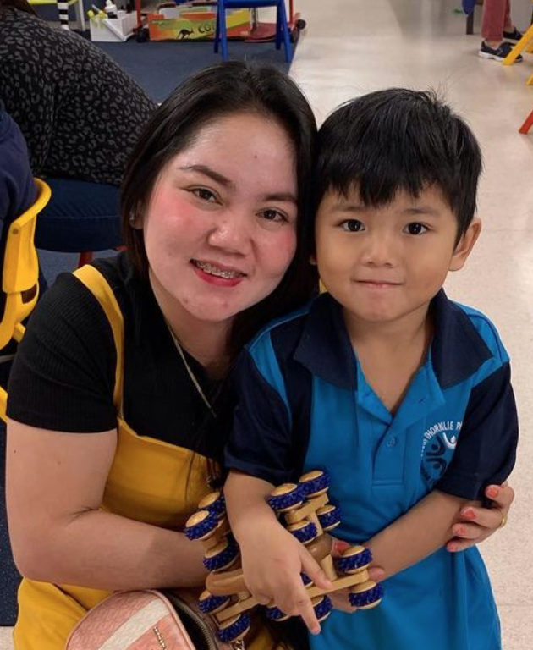
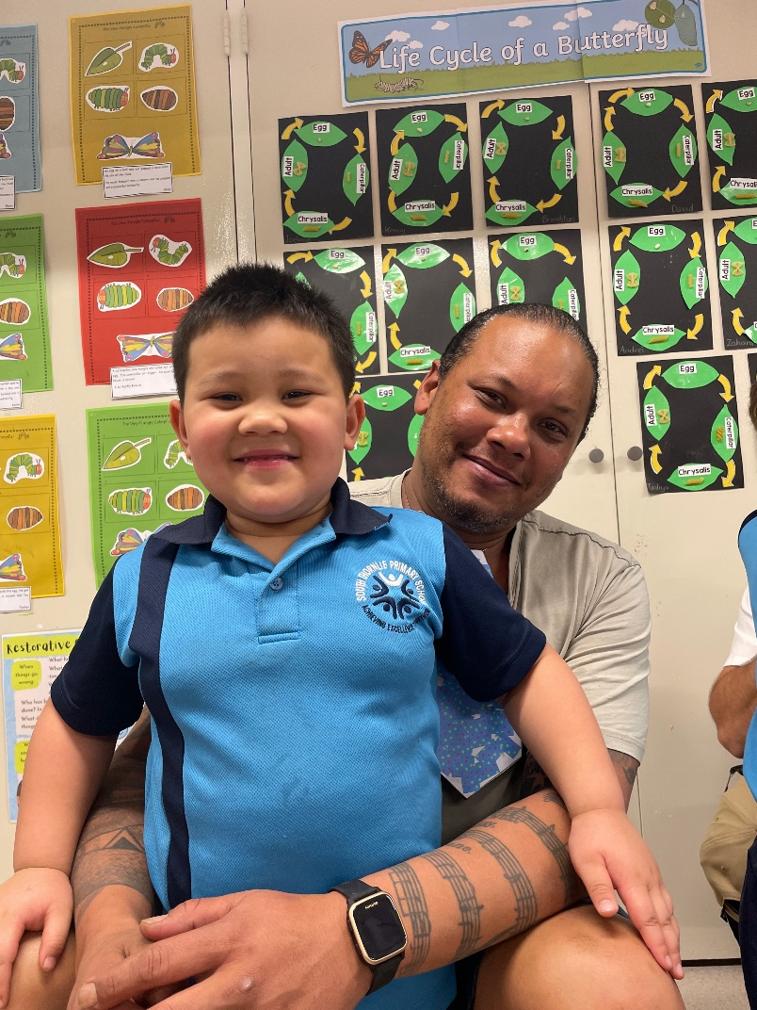
POSITIVE PARENT PRAISE 2023

Slide 2
PURPOSE
Parent participation and feedback indicates that the close connections the school has established are highly valued. The aim is to further develop a positive, integrated relationship between home and school environments for students and parents. An increase in frequent and high-quality interactions amongst teachers and parents can help establish better trust and respect.

Slide 3
CONSENT
All participants explicitly agreed to be interviewed and gave permission to record their responses - either written, audio or video.
They understood the purpose of their involvement and were made aware of how the information contained in their interview will be used.

Slide 4
PARENT INTERVIEWS
To collect our qualitative data we conducted 10 parent interviews we asked the following two questions:
1. What are your favourite aspects about the school?
2. How can the school improve?
We collated improvement feedback on another document to be shared at a later stage.

Slide 5
Kerr
Kenny (Kindy 2)
Mother: Haylee Kerr
Positive Feedback:
“We love the staff here at STPS.”
“My kid especially loves all the sporting events and just sports in general.”
Kenny Kerr and Jamase Nguyen
Kindy 2

Slide 6
Nguyen
Jamase (Kindy 2)
Mother: Anh Nguyen
Positive Feedback:
“This school is rated higher than other schools in the vicinity which was an important indicator in picking schools.”
“I love that the school recognises the kid's efforts through Sports Awards and Star of the Day.”

Slide 7
Stevens
Monica (Year 1)
Mother: Aki Stevens
Positive Feedback:
“Events that involve parents like this (Open Night) are good.”
“The staff are wonderful, Monica loves when they greet her in the mornings with her name. They really make good connections. ”
“I follow both Instagram and Facebook and they keep me informed about events, which I like.”
Monica Stevens
A1

Slide 8
Balbin
Zeus Andrei Balbin (Kindy 2)
Mother: Manilyn Balbin
Positive Feedback:
“I like how students and teachers are both friendly.”

Slide 9
Austria
Jolance (Year 1) and Allen (Year 2)
Mother: Jocelyn Sales
Positive Feedback:
“The community is very good, all friendly kids. I particularly like the diverse and safe environment.”
“The staff are good, all friendly and easily approachable.”
“I like the school facilities, like the labs, music room and LEGO club.”

Slide 10
Chanmul
Leon (Year 4 ) and Gemma (Year 5 )
Father: Anthony Titko
Positive Feedback:
“The school really makes an effort to help the kids when they are having issues.”
“My kids enjoy going to school for its activities, classes and their friends.”

Slide 11
Ireland
Positive Feedback:
”There are a lot of activities for the kids to enjoy.”
“I don't interact with the staff much but when I do, they’re very friendly.”
Brooklyn (Kindy 2 )
Mother: Shayla Campbell

Slide 12
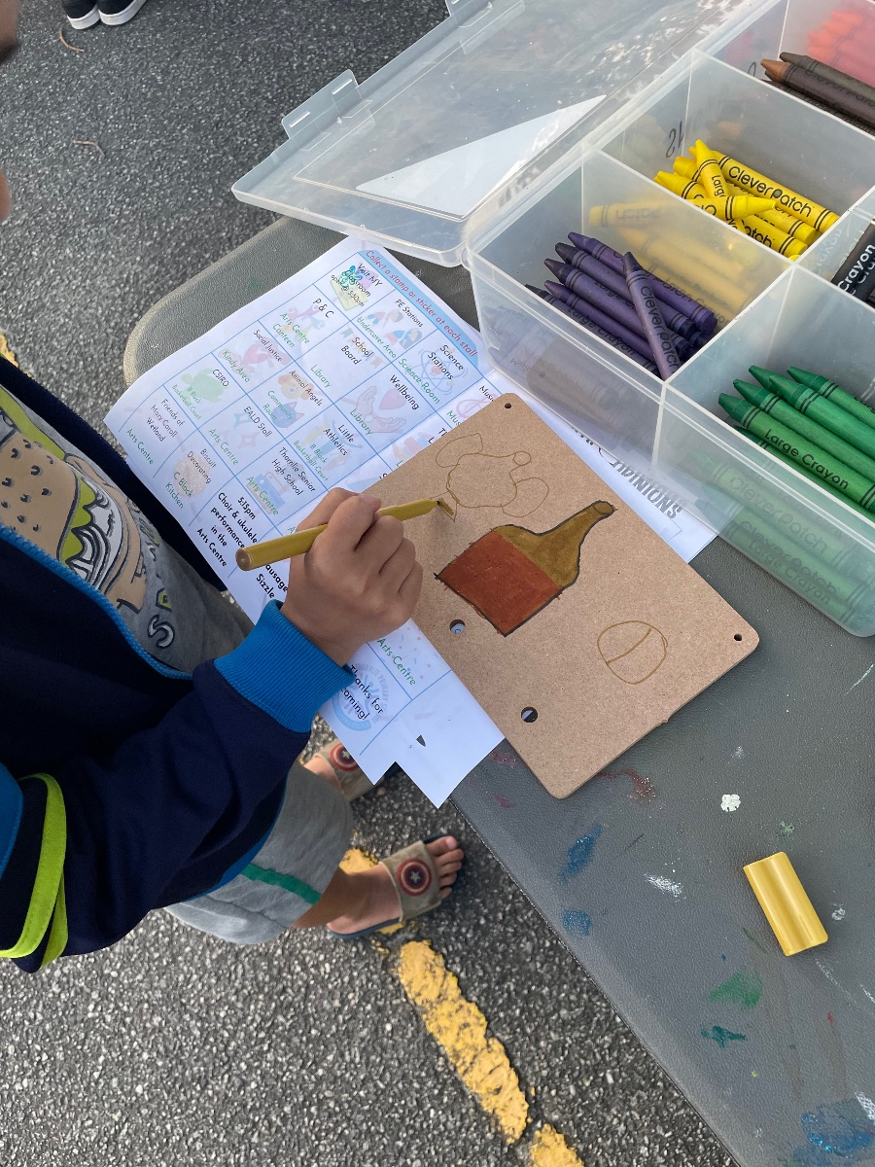
Chu
Ying Han (Year 2)
Father: Mark Chu
Positive Feedback:
“All the events are well-thought out, the staff look like they enjoy their job.”
“The school has really nice facilities, would've been nice when I was growing up.”

Slide 13
Vercoe
Positive Feedback:
“The staff are really good with the kids.”
“I attend all school events like this (Open Night) and like the community aspect about them.”
Lexcy (Year 1 )
Mother: Robbie Kopae

Slide 14
Neethidevan
Joshika (Year 2)
Father: Neethidevan Govindan
“The staff are awesome.”
“The school is great not only for academic but other (aspects).”
“Constantly improving.”

Slide 15
Thank you!

